Slide 1
Picture Techniques
COMP120: Creative Computing

Slide 2
Learning Objectives
By the end of this session you should be able to:
Implement controlled color changes using conditional logic
Separate background and foreground using subtraction

Slide 3
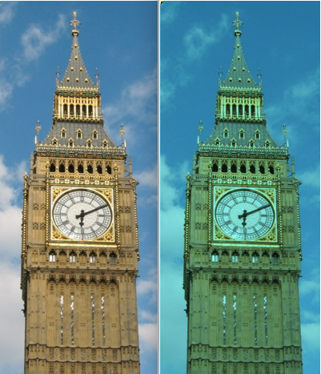
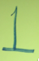
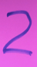
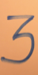
I want to make a changeRed function that will let me:
def changeRed(picture, amount):
for p in getPixels(picture):
value=getRed(p)
setRed(p,value*amount)
If “b” is the Big Ben picture, which of the below did this →
changeRed(b,1.5)
changeRed(b,2.0)
changeRed(b,0)
Notes:
#4

Slide 4
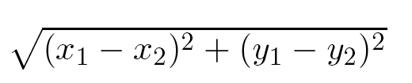
Distance between colors?
Sometimes you need to, e.g., when deciding if something is a “close enough” match
How do we measure distance?
Pretend it's cartesian coordinate system
Distance between two points:
Distance between two colors:

Slide 5
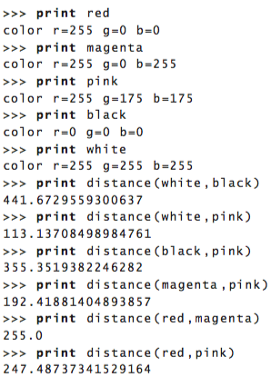
Trying distance()
Use the distance equation from the previous slide to write a function which accepts a two colours and returns the distance.
Test your solution
Then post your solution on Slack.

Slide 6
Introducing IF
if (some test):
#These Python statements will execute if true
print “This is true!”
print “This will print, either way.”
Computers can make choices.
They can perform tests.
Then execute different statements depending on the result of the test.

Slide 7
Tuning our color replacement
If you want to get more of Barb's hair, just increasing the threshold doesn't work
Wood behind becomes within the threshold value
How could we do it better?
Lower our threshold, but then miss some of the hair
Work only within a range…

Slide 8
Computing a distance between colors
What does it mean for a color to be “close” to another color?
We will compute a color distance, based on the formula for the distance between two points.

Slide 9
Replacing colors using IF
We don't have to do one-to-one changes or replacements of color
We can use if to decide if we want to make a change.
We could look for a range of colors, or one specific color.
We could use an operation (like multiplication) to set the new color, or we can set it to a specific value.
It all depends on the effect that we want.

Slide 10
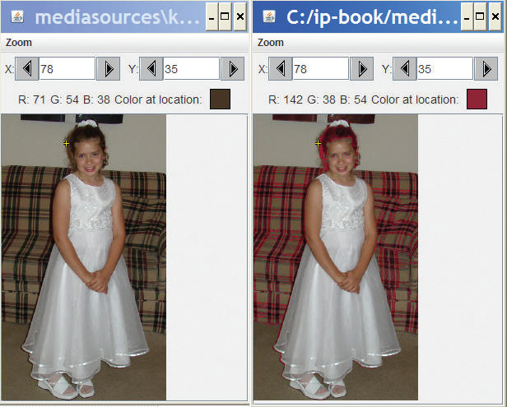
Working on Katie's Hair
def turnRed():
brown = makeColor(42,25,15)
file="/Users/guzdial/Desktop/mediasources/katieFancy.jpg"
picture=makePicture(file)
for px in getPixels(picture):
color = getColor(px)
if distance(color,brown)<50.0:
r=getRed(px)*2
b=getBlue(px)
g=getGreen(px)
setColor(px,makeColor(r,g,b))
show(picture)
return picture
This version doubles all “close” reds. Notice the couch.

Slide 11
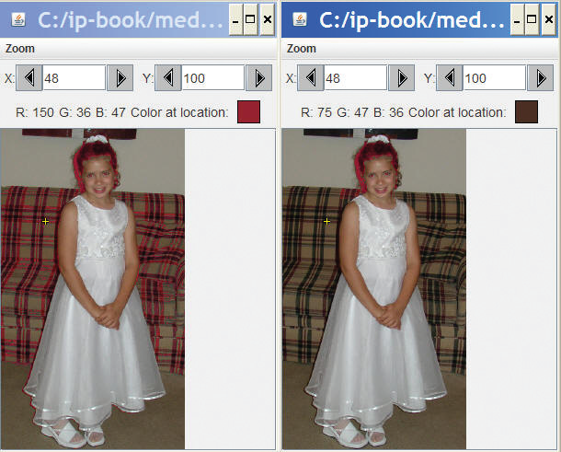
Working on Katie's hair, in a range
def turnRedInRange():
brown = makeColor(42,25,15)
file="/Users/guzdial/Desktop/mediasources/katieFancy.jpg"
picture=makePicture(file)
for px in getPixels(picture):
x = getX(px)
y = getY(px)
if 63 <= x <= 125:
if 6 <= y <= 76:
color = getColor(px)
if distance(color,brown)<50.0:
r=getRed(px)*2
b=getBlue(px)
g=getGreen(px)
setColor(px,makeColor(r,g,b))
show(picture)
return picture
Left is one we did with all “close” browns. Right is same, but only in rect around head.

Slide 12
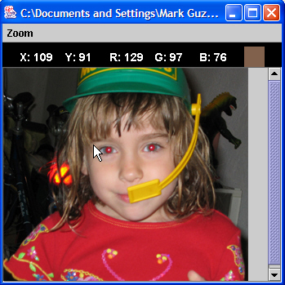
Removing “Red Eye”
When the flash of the camera catches the eye just right (especially with light colored eyes), we get bounce back from the back of the retina.
This results in “red eye”
We can replace the “red” with a color of our choosing.
First, we figure out where the eyes are (x,y) using MediaTools

Slide 13
Removing “Red Eye”
Write an algorithm which will reduce the red-eye in this image by finding a colour close to red and change it to make it more black.
Post your solution in Slack.

Slide 14
Removing Red Eye
def removeRedEye(pic,startX,startY,endX,endY,endColor):
for px in getPixels(pic):
x = getX(px)
y = getY(px)
if (startX <= x <= endX) and (startY <= y <= endY):
if (distance(red,getColor(px)) < 165):
setColor(px,endColor)
Why use a range? Because we don't want to replace her red dress!
What we're doing here:
Within the rectangle of pixels (startX,startY) to (endX, endY)
Find pixels close to red, then replace them with a new color

Slide 15
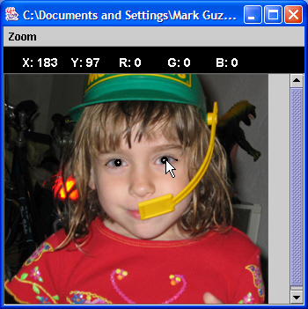
“Fixing” it: Changing red to black
removeRedEye(jenny, 109, 91, 202, 107, makeColor(0,0,0))
Jenny's eyes are actually not black—could fix that
Eye are also not mono-color
A better function would handle gradations of red and replace with gradations of the right eye color

Slide 16
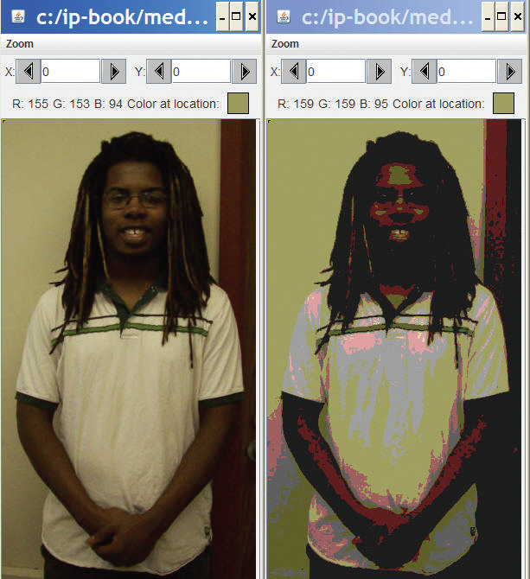
Posterizing: Reducing range of colors

Slide 17
Posterizing: How we do it
We look for a range of colors, then map them to a single color.
If red is between 63 and 128, set it to 95
If green is less than 64, set it to 31
...
It requires a lot of if statements, but it's really pretty simple.
The end result is that a bunch of different colors, get set to a few colors.

Slide 18
Posterizing function
def posterize(picture):
#loop through the pixels
for p in getPixels(picture):
#get the RGB values
red = getRed(p)
green = getGreen(p)
blue = getBlue(p)
#check and set red values
if(red < 64):
setRed(p, 31)
if(red > 63 and red < 128):
setRed(p, 95)
if(red > 127 and red < 192):
setRed(p, 159)
if(red > 191 and red < 256):
setRed(p, 223)
#check and set green values
if(green < 64):
setGreen(p, 31)
if(green > 63 and green < 128):
setGreen(p, 95)
if(green > 127 and green < 192):
setGreen(p, 159)
if(green > 191 and green < 256):
setGreen(p, 223)
#check and set blue values
if(blue < 64):
setBlue(p, 31)
if(blue > 63 and blue < 128):
setBlue(p, 95)
if(blue > 127 and blue < 192):
setBlue(p, 159)
if(blue > 191 and blue < 256):
setBlue(p, 223)

Slide 19
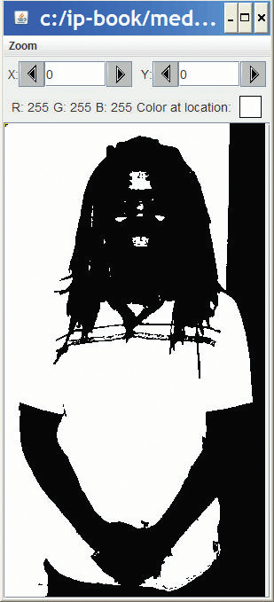
Posterizing to b/w levels
def grayPosterize(pic):
for p in getPixels(pic):
r = getRed(p)
g = getGreen(p)
b = getBlue(p)
luminance = (r+g+b)/3
if luminance < 64:
setColor(p,black)
if luminance >= 64:
setColor(p,white)
We check luminance on each pixel.
If it's low enough, it's black, and
Otherwise, it's white

Slide 20
Another way to do that
def grayPosterize(pic):
for p in getPixels(pic):
r = getRed(p)
g = getGreen(p)
b = getBlue(p)
luminance = (r+g+b)/3
if luminance < 64:
setColor(p,black)
else:
setColor(p,white)
We don't have to do both tests. We can just say else
It's easier to write, and it's more efficient.
But it can be harder to read, especially for new programmers.

Slide 21
Generating sepia-toned prints
Pictures that are sepia-toned have a yellowish tint to them that we associate with older pictures.
It's not directly a matter of simply increasing the yellow in the picture, because it's not a one-to-one correspondence.
Instead, colors in different ranges get mapped to other colors.
We can create such a mapping using IF

Slide 22
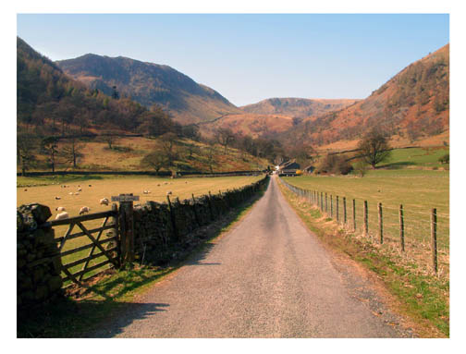
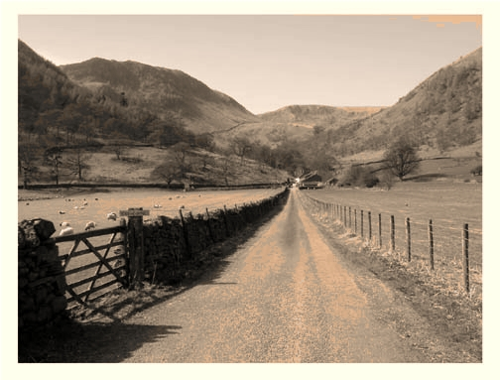
Example of sepia-toned prints

Slide 23
Here's how we do it
def sepiaTint(picture):
#Convert image to greyscale
greyScaleNew(picture)
#loop through picture to tint pixels
for p in getPixels(picture):
red = getRed(p)
blue = getBlue(p)
#tint shadows
if (red < 63):
red = red*1.1
blue = blue*0.9
#tint midtones
if (red > 62 and red < 192):
red = red*1.15
blue = blue*0.85
#tint highlights
if (red > 191):
red = red*1.08
if (red > 255):
red = 255
blue = blue*0.93
#set the new color values
setBlue(p, blue)
setRed(p, red)

Slide 24
What's going on here?
First, we're calling greyScaleNew (the one with weights).
It's perfectly okay to have one function calling another.
We then manipulate the red (increasing) and the blue (decreasing) channels to bring out more yellows and oranges.
Why are we doing the comparisons on the red? Why not? After greyscale conversion, all channels are the same!
Why these values? Trial-and-error: Twiddling the values until it looks the way that you want.

Slide 25
Edge Detection
Blurring is averaging across pixels.
Edge detection is looking for differences between pixels.
We draw lines that our eyes see—where the luminance changes.
If the pixel changes left-to-right, up and down, then we make our pixel black. Else white.

Slide 26
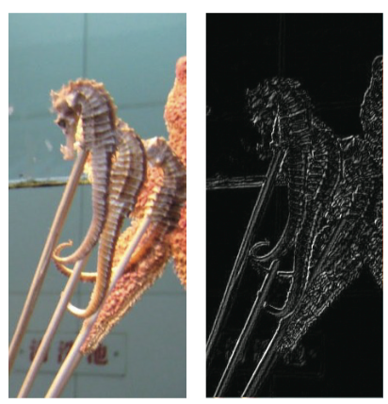
Edge Detection
def edge(source):
for px in getPixels(source):
x = getX(px)
y = getY(px)
if y < getHeight(source)-1 and x < getWidth(source)-1:
sum = getRed(px)+getGreen(px)+getBlue(px)
botrt = getPixel(source,x+1,y+1)
sum2 = getRed(botrt)+getGreen(botrt)+getBlue(botrt)
diff = abs(sum2-sum)
newcolor = makeColor(diff,diff,diff)
setColor(px,newcolor)

Slide 27
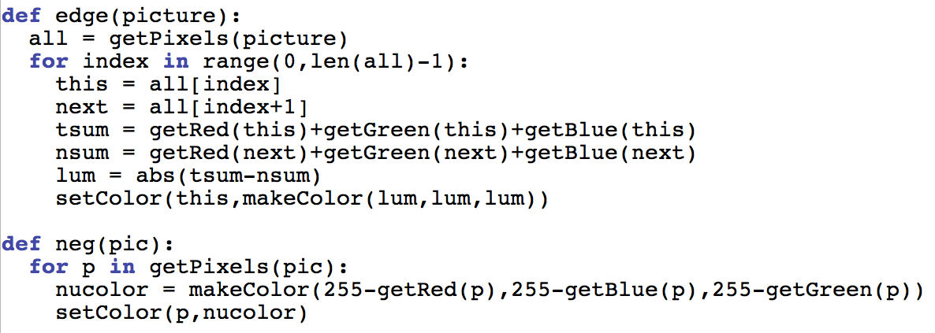
Even Simpler Edge Detection

Slide 28
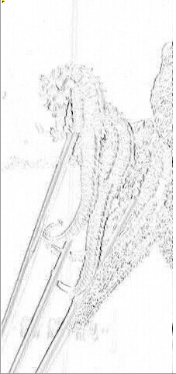
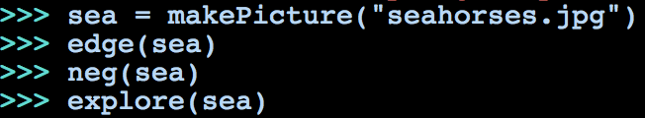
Edge detect, then negate

Slide 29
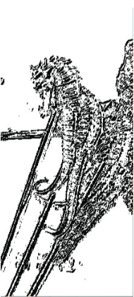
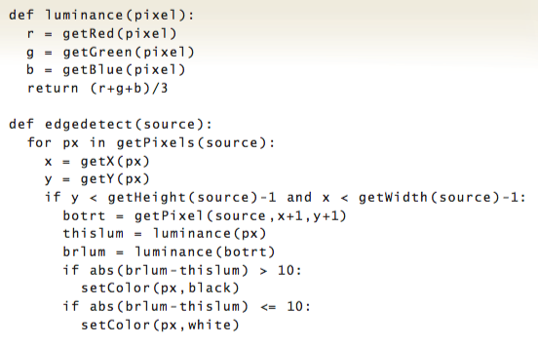
Yet Another Version

Slide 30
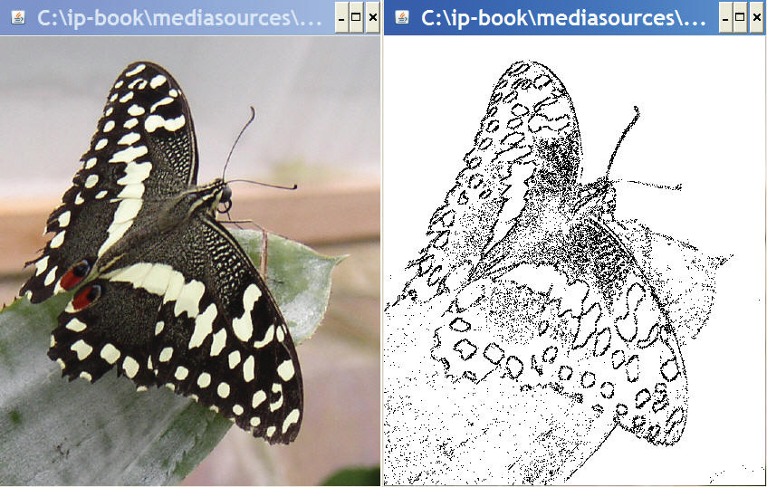
More Careful Edge Detection
def lineDetect(filename):
orig = makePicture(filename)
makeBw = makePicture(filename)
for x in range(0,getWidth(orig)-1):
for y in range(0,getHeight(orig)-1):
here=getPixel(makeBw,x,y)
down=getPixel(orig,x,y+1)
right=getPixel(orig,x+1,y)
hereL=(getRed(here)+getGreen(here)+getBlue(here))/3
downL=(getRed(down)+getGreen(down)+getBlue(down))/3
rightL=(getRed(right)+getGreen(right)+getBlue(right))/3
if abs(hereL-downL)>10 and abs(hereL-rightL)>10:
setColor(here,black)
if abs(hereL-downL)<=10 and abs(hereL-rightL)<=10:
setColor(here,white)
return makeBw
Here we look in all four directions.

Slide 31
Background subtraction
Let's say that you have a picture of someone, and a picture of the same place (same background) without the someone there, could you subtract out the background and leave the picture of the person?
Maybe even change the background?
Let's take that as our problem!

Slide 32
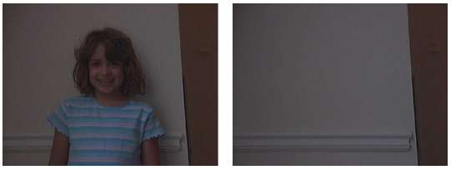
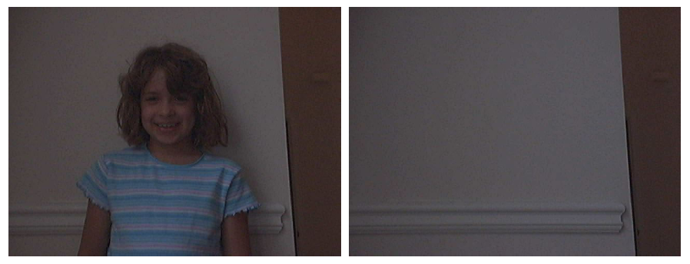
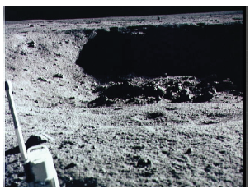
Person (Katie) and Background
Let's put Katie on the moon!

Slide 33
Where do we start?
What we most need to do is to figure out whether the pixel in the Person shot is the same as the in the Background shot.
Will they be the EXACT same color? Probably not.
So, we'll need some way of figuring out if two colors are close…

Slide 34
Using distance
So we know that we want to ask: if distance(personColor,bgColor) > someValue
And what do we then?
We want to grab the color from another background (a new background) at the same point.
Do we have any examples of doing that?

Slide 35
Where we are so far:
if distance(personColor,bgColor) > someValue:
bgcolor = getColor(getPixel(newBg,x,y))
setColor(getPixel(person,x,y), bgcolor)
What else do we need?
We need to get all these variables set up
We need to input a person picture, a background (background without person), and a new background.
We need a loop where x and y are the right values
We have to figure out personColor and bgColor

Slide 36
Swap a background using background subtraction
def swapBack(pict,bg,newBg):
for px in getPixels(pict):
x = getX(px)
y = getY(px)
bgPx = getPixel(bg,x,y)
pxcol = getColor(px)
bgcol = getColor(bgPx)
if (distance(pxcol,bgcol)<15.0):
newcol=getColor(getPixel(newBg,x,y))
setColor(px,newcol)
Specifying a threshold.

Slide 37
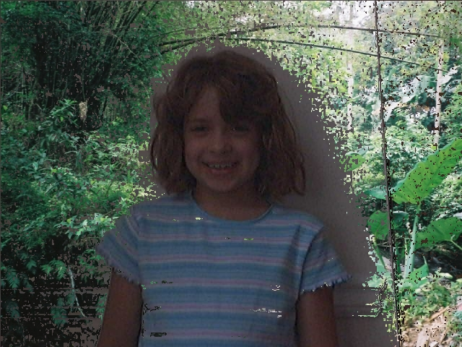
Works

Slide 38
But why isn't it alot better?
We've got places where we got pixels swapped that we didn't want to swap
See Katie's shirt stripes
We've got places where we want pixels swapped, but didn't get them swapped
See where Katie made a shadow

Slide 39
How could we make it better?
What could we change in the program?
We could change the threshold “someValue”
If we increase it, we get fewer pixels matching
That won't help with the shadow
If we decrease it, we get more pixels matching
That won't help with the stripe
What could we change in the pictures?
Take them in better light, less shadow
Make sure that the person isn't wearing clothes near the background colors.

Slide 40
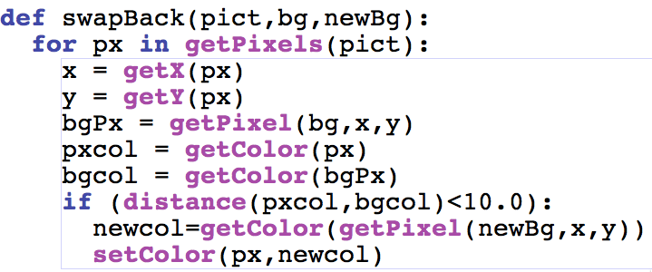
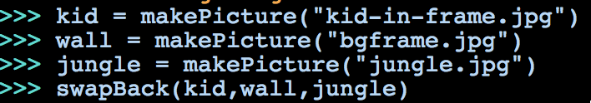
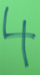
We call this function like this:
How do we see the result?
explore(kid)
explore(wall)
explore(jungle)
Notes:
#3

Slide 41
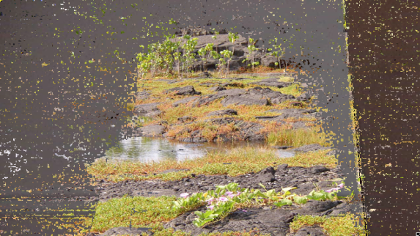
Playing with this program, you generate the above image. What do you predict changed?
You made the threshold value too high so too many pixels are matching both foreground and background
You made the threshold value too small so too few pixels are matching between the foreground and the background.
You changed the IF so that you inverted the swap
The jungle color is too close to the wall color. The moon would have worked better.
Notes:
#3

Slide 42
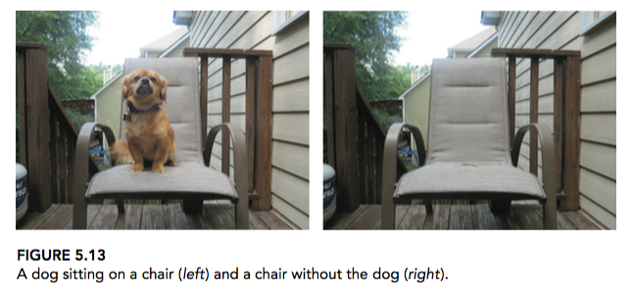
Putting a Dog on the Moon

Slide 43
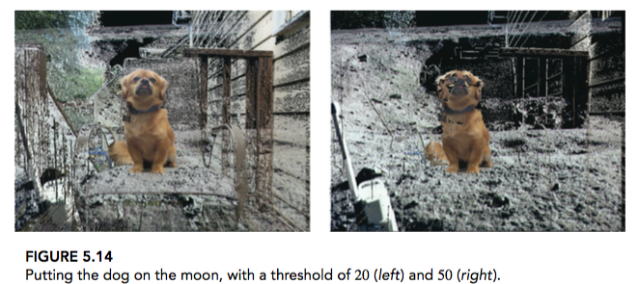
With different thresholds
>>> dog = makePicture("dog-bg.jpg")
>>> bg = makePicture("nodog-bg.jpg")
>>> swapBack(dog,bg,moon)
>>> explore(dog)

Slide 44
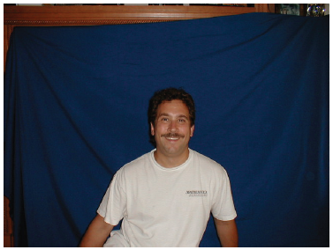
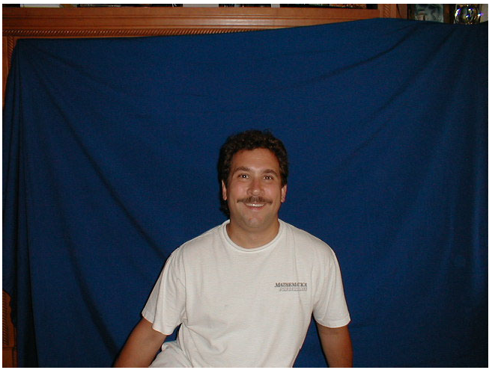
Another way: Chromakey
Have a background of a known color
Some color that won't be on the person you want to mask out
Pure green or pure blue is most often used
I used my son's blue bedsheet
This is how the weather people seem to be in front of a map—they're actually in front of a blue sheet.

Slide 45
Chromakey recipe
def chromakeyBlue(source,bg):
for px in getPixels(source):
x = getX(px)
y = getY(px)
if (getRed(px) + getGreen(px) < getBlue(px)):
bgpx = getPixel(bg,x,y)
bgcol = getColor(bgpx)
setColor(px,bgcol)

Slide 46
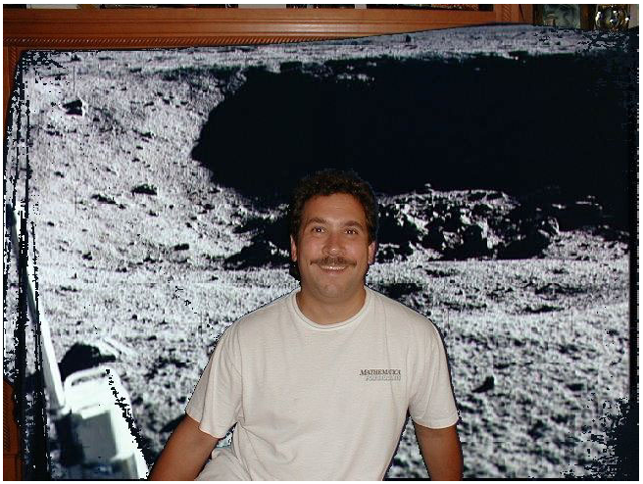
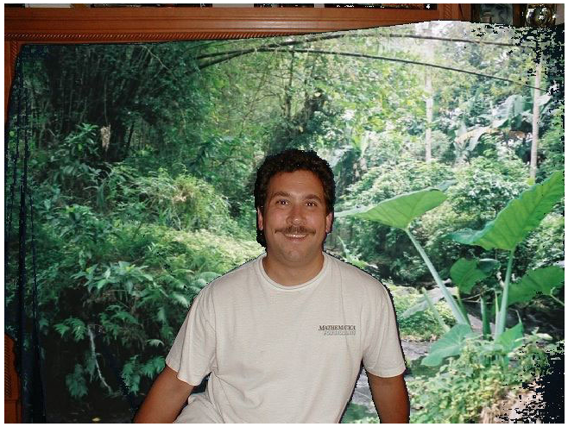
Example results

Slide 47
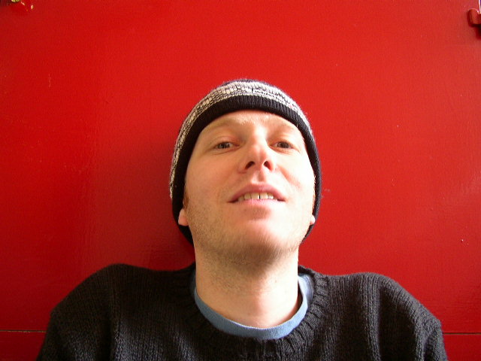

Just trying the obvious thing for Red
def chromakey2(source,bg):
# source should have something in front of red, bg is the new background
for p in getPixels(source):
if getRed(p) > (getGreen(p) + getBlue(p)):
#Then, grab the color at the same spot from the new background
setColor(p,getColor(getPixel(bg,getX(p),getY(p))))

Slide 48
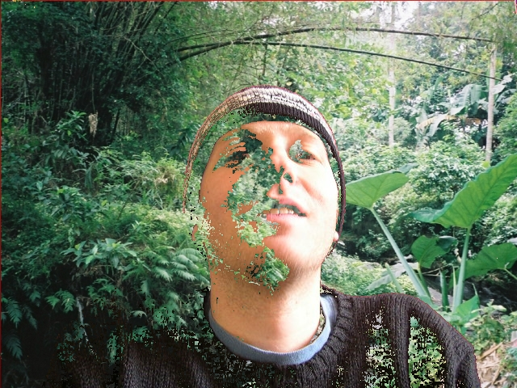
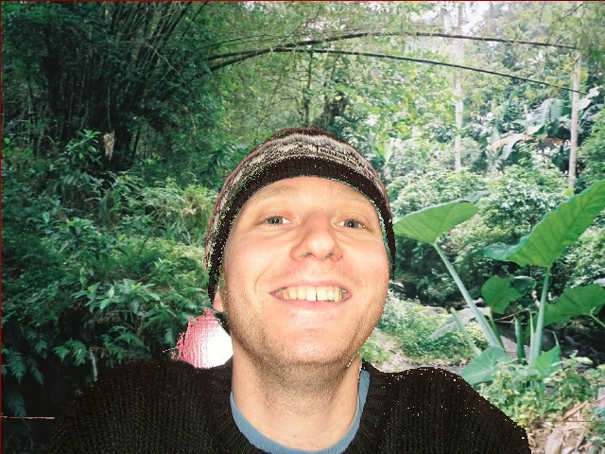
Doesn't always work as you expect

Slide 49
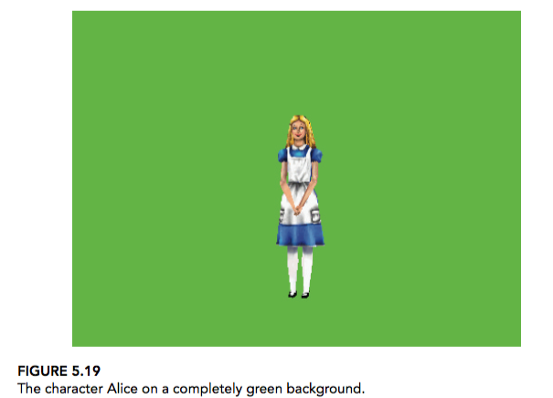
Easy to do with Alice
def chromakeyGreen(source,bg):
for px in getPixels(source):
x = getX(px)
y = getY(px)
if (getRed(px) + getBlue(px) < getGreen(px)):
bgpx = getPixel(bg,x,y)
bgcol = getColor(bgpx)
setColor(px,bgcol)\end{splpython}

Slide 50
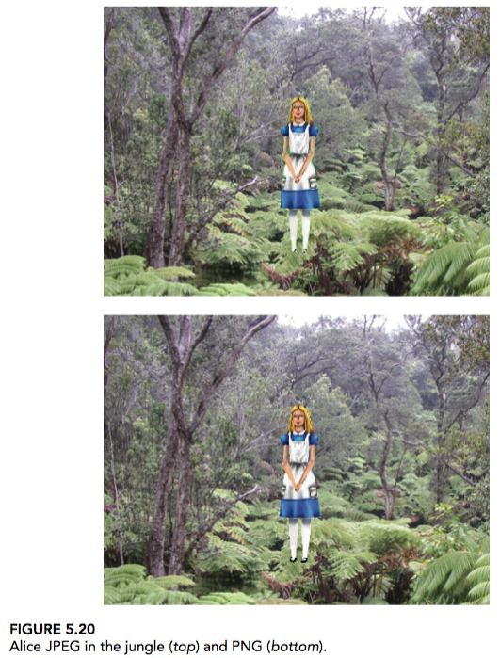
The difference between JPEG and PNG
Where did her shoes go?
Lossy vs. Lossless

Slide 51
Drawing on images
Sometimes you want to draw on pictures, to add something to the pictures.
Lines
Text
Circles and boxes.
We can do that pixel by pixel, setting black and white pixels

Slide 52
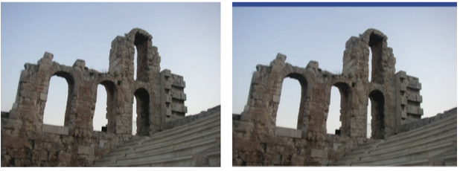
Drawing a border
def greekBorder(pic):
bottom = getHeight(pic)-10
for px in getPixels(pic):
y = getY(px)
if y < 10:
setColor(px,blue)
if y > bottom:
setColor(px,white)

Slide 53
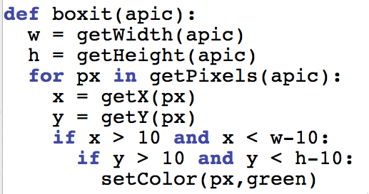
What does this program do?
(1) Covers a picture with green
(2) Creates a border of 10 pixels wide all green around a picture
(3) Creates a circle of green in the middle of the picture (4) Covers a picture with a green box, inset 10 pixels on each side.
Notes:
#1

Slide 54
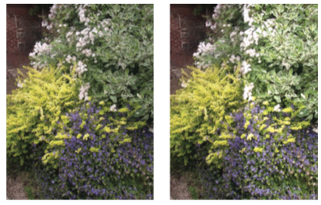
Lightening ½ of Picture
def rightHalfBright(pic):
halfway = getWidth(pic) / 2
for px in getPixels(pic):
x = getX(px)
if x > halfway:
color = getColor(px)
setColor(px,makeLighter(color))

Slide 55
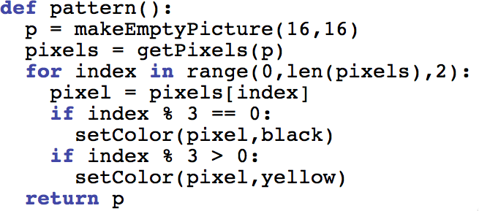
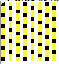
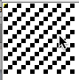
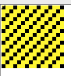
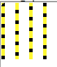
Consider this program:
Which picture below (zoomed to 500%) did this generate?
Notes:
#1

Slide 56
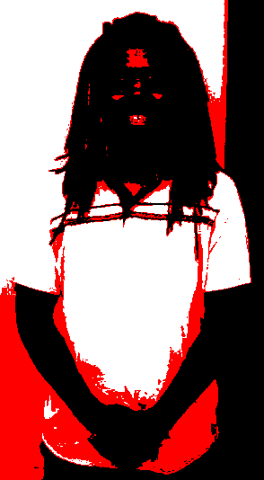
Posterizing to 3 levels: With elif and else
def posterizeBWR(pic):
for p in getPixels(pic):
r = getRed(p)
g = getGreen(p)
b = getBlue(p)
luminance = (r+g+b)/3
if luminance < 64:
setColor(p,black)
elif luminance > 120:
setColor(p,white)
else:
setColor(p,red)

